Slide 1
Drivers of Change: New World Order for Supply Chain & Clinical Services
Martie L. Moore, RN, MAOM, CPHQ
Chief Nursing Officer
Medline Industries, Inc.

Slide 2
DRIVERS OF CHANGE

Slide 3
Revenue Stream is Changing
HHS Framework categorizes healthcare payment according to how providers receive payment:
Category 1: Fee-for-service with no link of payment to quality
Category 2: Fee-for-service with a link of payment to quality
Category 3: Alternative payment models built on fee-for-service architecture
Category 4: Population-based payment
Value-based purchasing includes payments made in Categories 2 – 4. Moving from Cat. 1 to Cat. 4 involves two shifts:
Increasing accountability for both quality and total cost of care
A greater focus on population health management as opposed to payment for specific services
Source: https://www.cms.gov/Newsroom/MediaReleaseDatabase/Fact-sheets/2015-Fact-sheets-items/2015-01-26-3.html
DRIVERS OF CHANGE

Slide 4
Payment Taxonomy Framework
 | Category 1: Fee for Service: No link to Quality | Category 2: Fee for Service: Link to Quality | Category 3: Alternative Payment Models Built on Fee-for-Service Architecture | Category 4: Population-Based Payment
Description | Payments are based on volume of services and not linked to quality or efficiency | At least a portion of payments vary based on the quality or efficiency of healthcare delivery | Some payment is linked to the effective management of a population or an episode of care. Payments still triggered by delivery of services, but opportunities for shared savings or 2-sided risk | Payment is not directly triggered by service delivery so volume is not linked to payment. Clinicians and organizations are paid and responsible for the care of a beneficiary for a long period (e.g. ≥ 1yr.)
Medicare FFS | Limited in Medicare fee-for-service Majority of Medicare payments now are linked to quality | Hospital value-based purchasing Physician Value-Based Modifier Readmissions/Hospital Acquired Condition Reduction Program | Accountable care organizations Medical homes Bundled payments Comprehensive primary care initiative Comprehensive ESRD Medicare-Medicaid Financial Alignment Initiative Fee-for-Service Model | Eligible Pioneer accountable care organizations in years 3 - 5
Source: https://www.cms.gov/Newsroom/MediaReleaseDatabase/Fact-sheets/2015-Fact-sheets-items/2015-01-26-3.html
DRIVERS OF CHANGE

Slide 5
Rewarding Value
Where are we going?
HHS Goals:
30% of Medicare payments in Cat. 3 and Cat. 4 by end of 2016, and 50% in Cat. 3 and Cat. 4 by end of 2018.
85% of Medicare fee-for-service payments in Cat. 2 – 4 by 2016 and 90% by 2018.
How will this be achieved?
Alternative payment models (ACOs)
Advanced primary care medical home models
New models of bundling payment for episodes of care and continuum of care
Integrated care demonstrations for beneficiaries who are Medicare/ Medicaid enrollees
Source: https://www.cms.gov/Newsroom/MediaReleaseDatabase/Fact-sheets/2015-Fact-sheets-items/2015-01-26-3.html
DRIVERS OF CHANGE

Slide 6
Target Percentage
Medicare FFS payments linked to quality and alternative payment models in 2016 & 2018
All Medicare FFS (Categories 1-4)
FFS linked to quality (Categories 2-4)
2016
2018
Active payment models (Categories 3-4)
30%
50%
85%
90%
All Medicare FFS
Source: https://www.cms.gov/Newsroom/MediaReleaseDatabase/Fact-sheets/2015-Fact-sheets-items/2015-01-26-3.html
DRIVERS OF CHANGE

Slide 7
Clinical Lens: Care Transitions (Readmissions)
Influencers
Clostridium difficile⁽¹⁾
$4.8 billion in excess costs
1 in 5 Clostridium difficile patients experience a recurrence
Falls⁽²⁾
$34 billion in direct medical costs
734,000 hospitalizations
Skin Health⁽³⁾
$11 billion total annual cost (pressure ulcers)
2.5 million pressure ulcers treated in US acute care
http://www.cdc.gov/media/releases/2015/p0225-clostridium-difficile.html
http://www.cdc.gov/media/releases/2015/p0225-clostridium-difficile.html
http://www.ncbi.nlm.nih.gov/pmc/articles/PMC2810192/
DRIVERS OF CHANGE

Slide 8
Clinical Lens: Sepsis & Patient Experience
Sepsis
CAUTI
CLABSI
HAI
Urosepsis
Blood Stream
Pneumonia
Infectious Diseases
UTI
Maintenance
Patient Experience
“There is no neutrality in patient experience: It is either positive or it is negative.”
DRIVERS OF CHANGE

Slide 9
Three Levels of Maturity
Foundation Model
Optimization Model
Transformation Model
Departmental approach
View supply chain as a pipeline for products and services
Aim to supply the hospital with required materials
Limited focus on efficiency and productivity
Focus: Operations
Hospital-wide approach
Utilize outsourcing, spend analysis, and standardization to support procurement
Characterized by close collaboration between health and non-health professionals
Focus: Cost and Efficiency
Patient-centric approach
Implement lean materials management
Judge products based on their contribution to organizational and clinical goals
Incorporate improvements in clinical protocols in SCM decision making
Focus: Cost, Efficiency, and Quality Clinical Outcomes
Get Supplies In
Reduce Costs and Improve Efficiency
Increase Value by Elevating Quality of Care
Lowest product price paid
Realized operating cost saving targets
Optimized operational costs with a total cost of ownership focus
Performance Indicators
Reduced stock-outs
Reduced inventory carrying costs
Systems integrated to reduce medical errors and improve safety
Standardized tools, processes, and systems
Operational procurement processes and systems streamlined and automated
Reduced lead time and stock-out risks
Increased compliance with contracts to reduce organizational purchasing risk
Reduced procurement errors
Improved clinical outcomes and patient safety
Focus on ensuring the hospital can run
Aim to reduce spending on products and improve efficiency to realize reductions in operational costs
Balance between cost, efficiency, and ensuring positive patient outcomes
Operations – Focus on operations and spend
Efficiency – Improve process efficiency
Quality – Focus on patient safety and clinical outcomes
Source: http://www.strategyand.pwc.com/media/uploads/Strategyand-Transformative-Hospital-Supply-Chain.pdf
DRIVERS OF CHANGE

Slide 10
Lens of the Team: Pressure Ulcers
Foundation Model
Clinical Foundation Model
Departmental approach
View supply chain as a pipeline for products and services
Aim to supply the hospital with required materials
Limited focus on efficiency and productivity
Focus: Operations
Sees supplies as a by-product
Limited focus on efficiency and productivity
Outcomes seen as a nursing issue
Get Supplies In
Lowest product price paid
Reduced stock-outs
Focus on ensuring the hospital can run
Focus on Operations
Source: http://www.strategyand.pwc.com/media/uploads/Strategyand-Transformative-Hospital-Supply-Chain.pdf
DRIVERS OF CHANGE

Slide 11
Lens of the Team: Pressure Ulcers
Optimization Model
Clinical Team Optimization Model
Hospital-wide approach
Utilize outsourcing, spend analysis, and standardization to support procurement
Characterized by close collaboration between health and non-health professionals
Focus: Cost and Efficiency
Hospital-wide approach
Utilizing nursing data to provide analytics for improvement and outcomes
Interdiscipline is a nomenclature
Reduce Costs and Improve Efficiency
Realized operating cost saving targets
Reduced inventory carrying costs
Standardized tools, processes, and systems
Reduced lead time and stock-out risks
Reduced procurement errors
Aim to reduce spending on products and improve efficiency to realize reductions in operational costs
Focus on Outcomes
Source: http://www.strategyand.pwc.com/media/uploads/Strategyand-Transformative-Hospital-Supply-Chain.pdf
DRIVERS OF CHANGE

Slide 12
Lens of the Team: Skin Health
Transformation Model
Patient-centric approach
Implement lean materials management
Judge products based on their contribution to organizational and clinical goals
Incorporate improvements in clinical protocols in SCM decision making
Focus: Cost, Efficiency, and Quality Clinical Outcomes
New Models
Medical Home Models
Population Health
Analytics
Increase Value by Elevating Quality of Care
Optimized operational costs with a total cost of ownership focus
Systems integrated to reduce medical errors and improve safety
Decision Support
Operational procurement processes and systems streamlined and automated
Increased compliance with contracts to reduce organizational purchasing risk
Improved clinical outcomes and patient safety
Balance between cost, efficiency, and ensuring positive patient outcomes
COMMUNITY
ACUTE
POST-ACUTE
Across the Continuum of Care
Source: http://www.strategyand.pwc.com/media/uploads/Strategyand-Transformative-Hospital-Supply-Chain.pdf
DRIVERS OF CHANGE

Slide 13
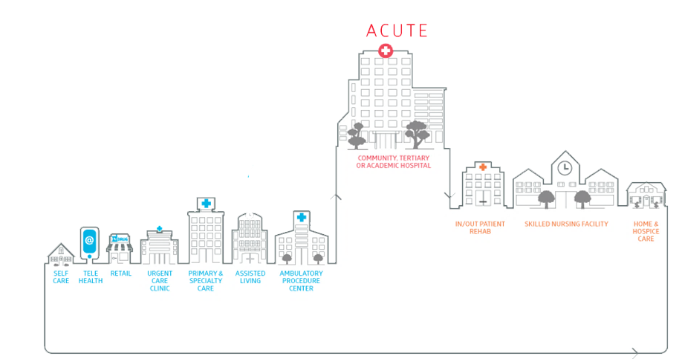
Supply Chain & Clinical Services
Strategies must be integrated across continuum of care
POST-ACUTE
COMMUNITY
Population Health Management
DRIVERS OF CHANGE

Slide 14
Disruptors
…or are they?
DRIVERS OF CHANGE

Slide 15
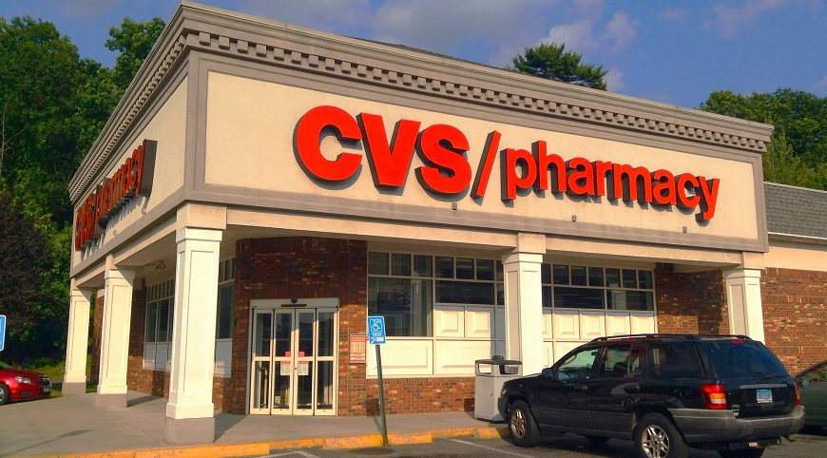
Retail Health Care
CVS Minute Clinic Strategic Pillars
Supporting Primary Care
National Footprint
Provider presence
New Clinical Services
Common chronic diseases, Health & Wellness
TeleHealth
Reach
Care Coordination and Integration with Health Systems and PCPs
1
2
3
4
National Care Delivery Platform
DRIVERS OF CHANGE

Slide 16
Do, or do not. There is no try.
– Yoda
DRIVERS OF CHANGE

Slide 17
Thank You!
Questions?

