Slide 1
Engaging Physicians and Suppliers In The Value Based Purchasing Era
California Association of Healthcare Purchasing & Materials Managers
Shell Beach, California
October 2014
Aman Sabharwal, MD, MHA, CPHM
SVP of Clinical Resource Management

Slide 2
Introductions
Aman Sabharwal, M.D., M.H.A., CPHM
  SVP Clinical Resource Management, MedAssets
  Practicing Hospitalist
  Clinical Assistant Professor of Medicine
    University of Miami Miller School of Medicine
    Florida International University College of Medicine
  14+ years healthcare experience
  Areas of expertise
      Clinical Efficiency
      Quality & Utilization

Slide 3
Impact of Healthcare Reform

Slide 4
2009 | 2010 | 2011 | 2012 | 2013 | 2014 | 2015
EMR/Meaningful Use |  | PHASE 1 |  | PHASE 2 |  | PHASE 3
Healthcare Reform 3/2010 |  | Implement expanded insurance coverage, Medicaid expansion.
Health Insurance Exchanges Data
Value Based Purchasing Yr 1 –F2013 on F2012 Performance. |  |  |  | Value Based Purchasing Continues. Penalties and Rewards increase for Quality Performance.
Comparative Effectiveness
Accountable Care Organization Program Jan 2012
Payment Bundling Pilot Program Jan 2013
30 Day Readmits Program FY2013
ICD10 Compliance – 10/2014 ?
Hospital Acquired Conditions Program F2015. Readmission Reduction Program
CMS - from Fee For Service Volume Model Transition to…..Value – High Quality/ Low Cost
Notes:
Pay for perf and Pt Sat – Value Based Purchasing
Core measures - readmission

Slide 5
Value Based Purchasing
Required by Congress under Section 1886(o) of the Social Security Act
Next step in promoting higher quality care for Medicare beneficiaries
CMS views value-based purchasing as an important driver in revamping how care and services are paid for, moving increasingly toward rewarding better value, outcomes, and innovations instead of volume
Legislation requires that the FY 2013 Hospital VBP program apply to payments for discharges occurring on or after October 1, 2012
Hospital VBP measures must be included on Hospital Compare website for at least one year and specified under the Hospital IQR program

Slide 6
Value Based Purchasing
VBP was established by the Affordable Care Act of 2010 (ACA)
Budget neutral payment changes begin October 1, 2012
Physician payment changes begin January 1, 2015
Rewards for achievement or improvement

Slide 7

Impact on Hospitals

Slide 8
Imperatives for Hospital’s Future Success
Manage costs to reimbursement
  Educating providers about margin
  Educating providers about reimbursement schemes
Align incentives for hospital, physicians and non-acute providers (preparation for ACO)
Migrate from fee-for-volume to fee-for-quality
  Value Based Purchasing
Focus on chronic disease management
  Bundled payments
  Episodes of care

Slide 9
Value-Based Purchasing
Congress authorized CMS to reduce the reimbursement of over 3,000 hospitals in the Affordable Care Act to reinforce improving healthcare quality, including the patient experience and efficiency.
Hospitals have an incentive to improve quality and earn the reimbursement back by achieving higher than average quality scores.
Simply stated, hospitals with below average quality provide the incentive pool via CMS fund the bonus payments for those above average.
This money is then redistributed to hospitals based on the quality of care.
Source: CMS QualityNet

Slide 10
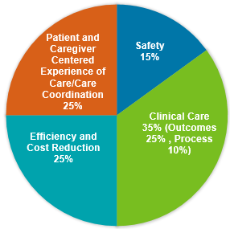
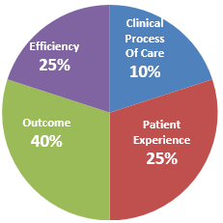
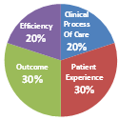
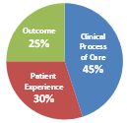
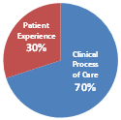
Reimbursement @ Risk Increases Annually
+ Incentives Lost to Competitors Add to Cost of Poor Quality

Slide 11
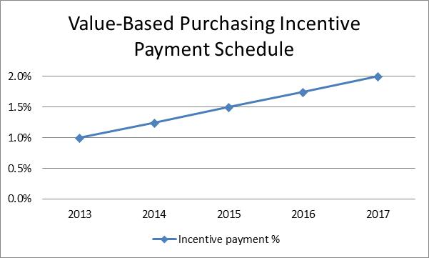
Funding Value Based Purchasing

Slide 12
Earning Your Score
Achievement or Improvement
  Achievement 0-10 points
  Improvement 0-9 points
  Highest of either score used
Achievement Points
  Must meet threshold (performance at 50th percentile)
  Based on where performance falls
Improvement Points
  Performance compared to baseline
  CMS: no full credit for improvement
Notes:
A hospital will earn 0-10 points for achievement based on where its performance for each measure falls relative to the achievement benchmark (performance at the mean of the top decile) and the achievement threshold (performance at the 50th percentile); points will be only be awarded for achievement above the threshold.
A hospital will earn 0-9 points based on its performance improvement on the measure compared with the baseline period for the measure. (CMS believes that a hospital should not receive full credit—that is, the maximum ten points—for improving.)
HCAHPS points will be awarded based on consistency, as long as all measures are above the floor (minimum performance).
CMS will compare the achievement and improvement scores for each measure and the highest score will be awarded; these final scores for each measure will be added to reach the hospital’s total performance score.

Slide 13
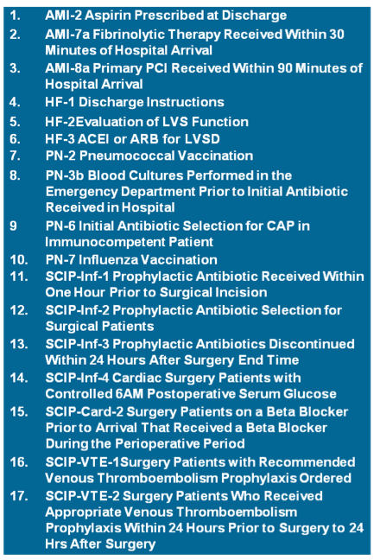
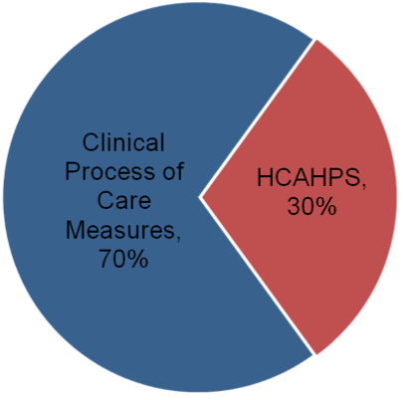
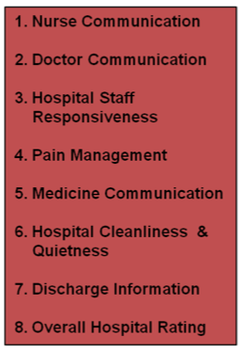
FY 2013 Domains & Measures
Notes:
Quality measures from Hospital Compare measure set
20 measures (12 Process of Care / 8 HCAHPS dimensions) in FY 13, and
Adds 13 new measures (3 mortality, 8 HACs, and 2 IQI/PSIs) in FY 14
Subsequent proposals were made after this rule

Slide 14
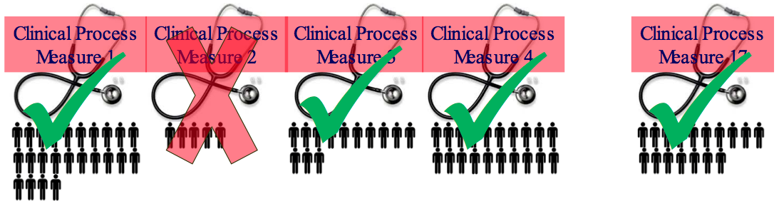
Eligibility for VBP Measures
Hospitals with at least 10 cases for at least 4 applicable measures during the performance period receive a Clinical Process of Care score
Hospitals with at least 100 Hospital Consumer Assessment of Healthcare Providers and Systems (HCAHPS) surveys during the performance period receive a Patient Experience of Care score

Slide 15
Who Gets Impacted
Median
Hospital A receives payment incentive
Hospital B loses 1%
Hospital C receives payment incentive

Slide 16
FY 2013 Timeline
Final Payment
Adjuster Delivered
Estimated Payment
Adjuster Delivered
Aug
Nov
2009
2010
2011
2012
2013
July
March
July
March
FY 2013 Baseline Period
FY 2013 Performance Period

Slide 17
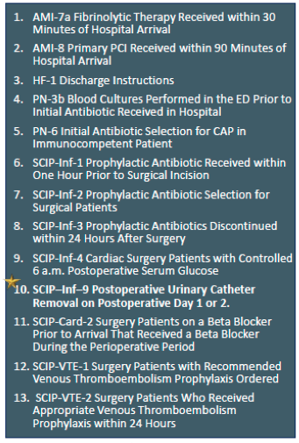
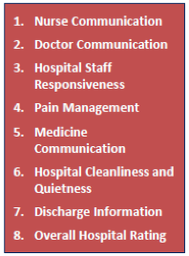
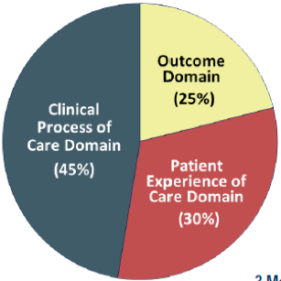
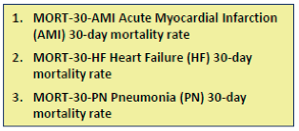
FY 2014 Domains & Measures

Slide 18
FY 2014 Timeline
2009
2010
2011
2012
2013
April
December
April
December
FY 2014 Baseline Period
FY 2014 Performance Period

Slide 19
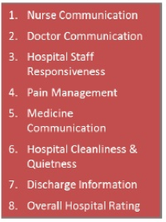
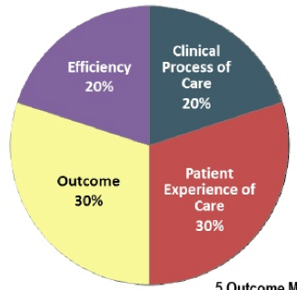
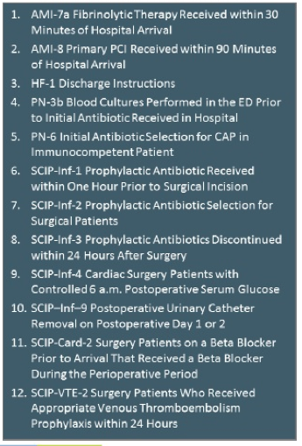
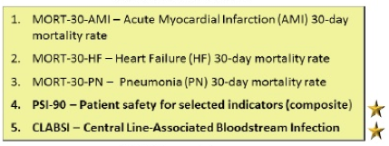
FY 2015 Domains & Measures
1. MSBP-1. Medicare Spending Per Beneficiary (MSPB) Measure

Slide 20
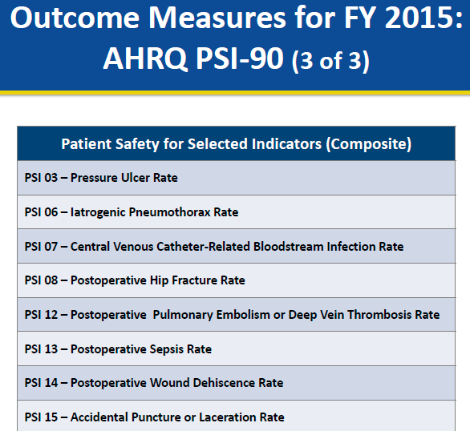
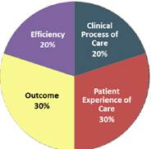
FY 2015 Patient Safety Composite Index

Slide 21
FY 2015 Timeline
2009
2010
2011
2012
2013
Various
Various
Various
December
FY 2015 Baseline Period
FY 2015 Performance Period

Slide 22
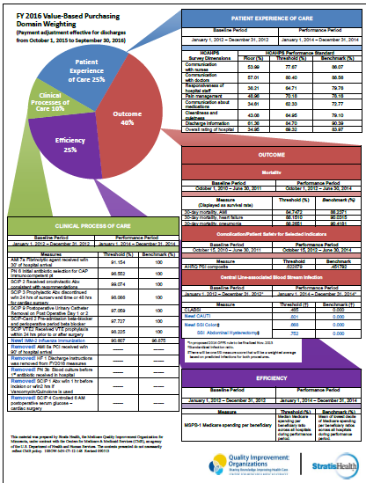
FY 2016 Domains & Measures

Slide 23
FY 2016 Timeline
2010
2011
2012
2013
2014
October
July
October
January
July
FY 2016 Baseline Period
FY 2016 Performance Period

Slide 24
What’s New for FY 2015-2017?
Readmission Reduction Program
  2013
    AMI, Pneumonia, Heart Failure
  2015
    COPD, Total Hip Replacement, Total Knee Replacement
Hospital Acquired Condition (HAC) Reduction Program
  In tandem with the Value Based Purchasing Program (VBP)
  Top 25% for HAC rates will receive a 1% reduction in their overall Medicare reimbursement rate

Slide 25
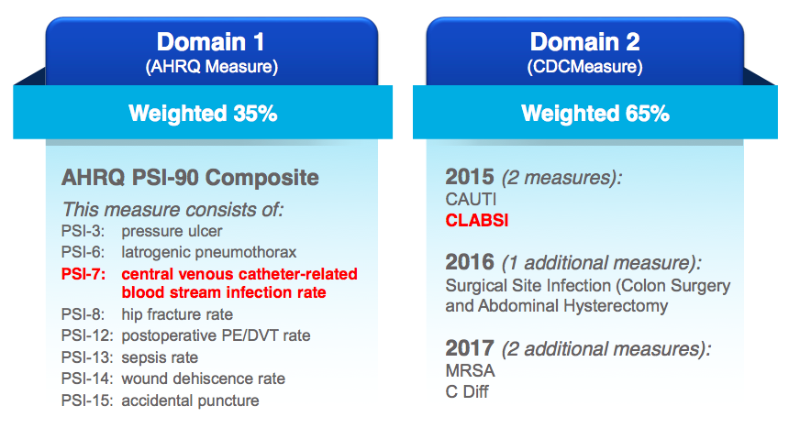
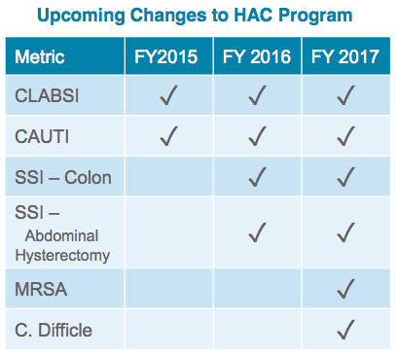
CMS Hospital Acquired Condition Reduction Program

Slide 26

Impact on Physicians

Slide 27
Impact on Physicians
Streamlined insurance claims processing
  Reduces physician practice overhead
10% incentive Medicare payment for PCP
10% incentive Medicare payment for Gen Surgeon in rural setting
5% incentive for mental health services
Increases Medicaid payments to PCP to Medicare level
Extends PQRS
Value-Based Payment Modifiers
Expands preventive and screening benefits
Transparency
  Drug/device company disclosures
  Limits on physician owned hospital
Funding to test medical liability reforms
  Ex: health courts and disclosure laws
Notes:
SGR sustainable growth rate formula (BBA 1998 Clinton); every year Medicare will decrease reimbursement to MDs by some percent to keep the growth rate of Medicare spending even. Has been repealed a few times. Will it all hit the MDs now? Not mentioned in ACA at all.

Slide 28
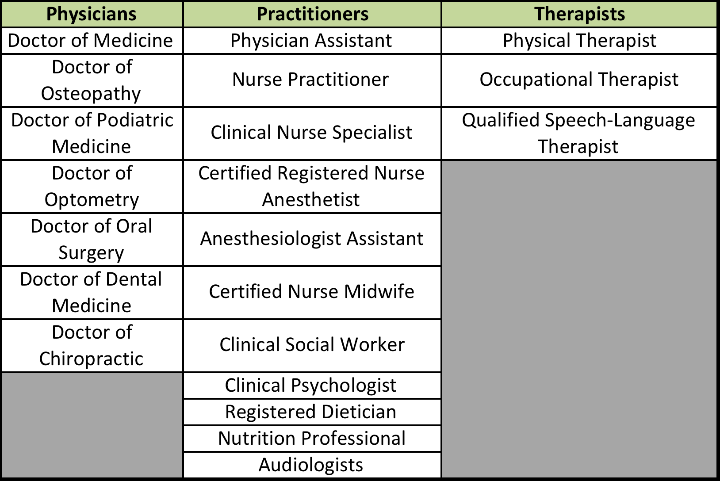
Eligible Practitioners (PQRS)

Slide 29
Value-Based Physician Payments Modifier
Section 3007 of the Affordable Care Act mandate
  CMS applies a value modifier under the Medicare Physician Fee Schedule (MPFS)
  Both cost and quality data are to be included in calculating payments for physicians
Value Modifier
  Physician or group differential payments based on quality and cost of care delivered (PQRS)
  Rewards practitioners for doing the “right thing” for the patient
Timeline
  Differential payments begin CY 2015
  Performance periods begin CY 2013

Slide 30
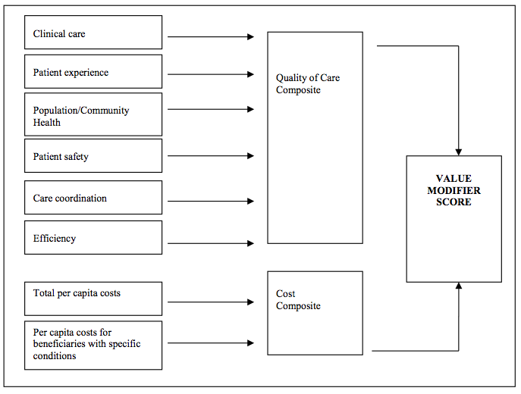
Physician Domains & Measures

Slide 31
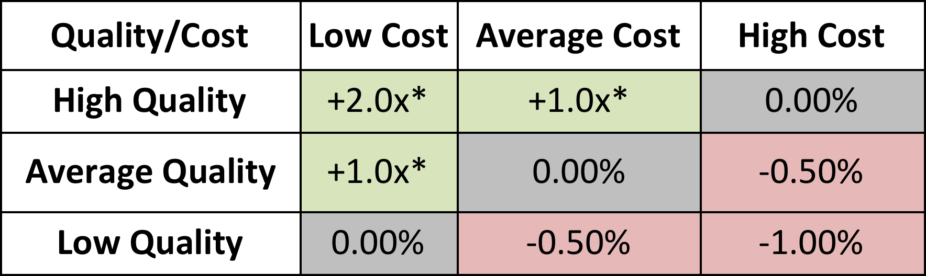
Physician Modifier Penalties & Incentives
Penalties used to cover incentive payments
  1.5% penalty 2015; 2% penalty 2016
  Groups >100 must register PQRS to avoid additional 1% penalty
Eligible for an additional +1.0x - +2.0x if:
  Reporting criteria are met
  Scores are in the top 25th percentile
Example: IF payment adjustment factor (x) is 0.75%:
  High quality/low cost groups of physicians could receive a 1.5% (2 x 0.75) upward payment adjustment

Slide 32

Synergies Exist Between All Hospital and Physician Domains
Medicare Spending per Beneficiary
Cost Composite Score

Slide 33
Key Approaches to Engaging Physicians
Position physician champions to lead clinical initiatives by…
  Clinical leadership and accountability
  Oversight and initiative direction
  Allowing for interpretation of quality and cost per case data
  Determining key areas of focus for appropriate clinical resource utilization
  Enhancing physician knowledge and skills
Notes:
The next few slides take principles of engaging physicians in change and customize them for Clinical Transformation.
Set up pilots to test new CPOE enabled process and the approach to supporting rollout
Focus on process of care not just the orders
Include all disciplines and ancillary departments in the design process
Design user friendly interface, minimizing the need for training
Ensure systems are fast and reliable
Provide adequate workstations to permit convenient computer access

Slide 34

Role Of The Suppliers

Slide 35

How Can Suppliers Partner with Health Systems and Providers to Drive Quality?
What products do suppliers have that can improve:
  Patient Safety
  Quality of Care
  Length of Stay
  Readmission
  Hospital Acquired Conditions
  Patient Satisfaction
What products do we have that may have secondary advantages to benefit hospitals under the ACA/VBP/HAC/Readmission Programs?

Slide 36

Supplier Innovations Support Quality Improvement
Nutritional Support protocols have proven to reduce Length of Stay
Suppliers can add features to urinary catheter kits to make it easier for care givers to remove the catheters proven to reduce infection
Coronary Artery Bypass Graft surgical site infections could be reduced with easier to understand medication and dosing
Electronic Health Records software has been modified to simplify use of correct order sets and reminders to caregivers making the core measures easier to achieve 100% compliance
We need to capture the resources of our suppliers to improve quality
Supplier Resource Management - NOT just purchasing
Suppliers need to think in an innovative fashion and promote themselves in this arena – we need to be asking them the questions!

Slide 37
Surgical Care Improvement Through Nutritional Optimization

Slide 38
Surgical Complications
SSI are #1 Hospital Acquired Condition¹
Infections are #1 cause of morbidity after surgery¹
Infections prolong hospital stays²
Infections increase US healthcare costs by ~$10B annually³
Surgical stress predisposes patients to immune dysfunction⁵
  Increases risk of infection
  More so when malnourished
Various nutrient and nutritional strategies have been studied to evaluate their effect on immune function & clinical outcomes (Drover, et al)
Notes:
Perioperative Use of Arginine-supplemented Diets: A Systematic Review of the Evidence
John W Drover, MD, FRCSC, Rupinder Dhaliwal, RD, Lindsay Weitzel, PhD, Paul E Wischmeyer, MD, Juan B Ochoa, MD, FACS, Daren K Heyland, MD, FRCPC, MSC

Slide 39
What Is Arginine?
Amino acid involved in multiple metabolic processes
Precursor of polyamines and hydroxyproline¹⁰
  Connective tissue repair
Precursor of nitric oxide¹⁰
  Signaling molecule
Essential metabolic substrate for immune cells and required for normal lymphocyte function¹¹
Deficiency occurs after surgical stress^{11,12}
  Mechanisms unknown
Meta-analysis of RCTs evaluating perioperative arginine in elective surgical patients showed a statistically significant reduction in infectious complications and shorter LOS
  No overall effect on mortality
Notes:
Perioperative Use of Arginine-supplemented Diets: A Systematic Review of the Evidence
John W Drover, MD, FRCSC, Rupinder Dhaliwal, RD, Lindsay Weitzel, PhD, Paul E Wischmeyer, MD, Juan B Ochoa, MD, FACS, Daren K Heyland, MD, FRCPC, MSC

Slide 40
Types of Elective Surgical Cases (RCTs)
Upper GI Malignancy
Lower GI Malignancy
Pancreatic Malignancy
Other Elective GI Surgery (Upper and Lower)
Head & Neck Malignancy
GYN Malignancy
Cardiac Surgery

Slide 41
Elective GI Malignancy Surgery
Patients with complications following surgery for GI Cancer had a mean additional hospital cost of $21,490 per stay vs. pateints without complications
Having postop complications increases readmission by a factor of 4.2x
Having postop complications increases LOS by 3-5 days

Slide 42
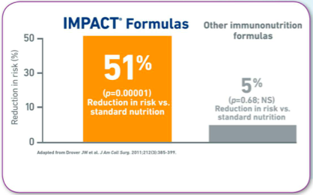
Nestlé IMPACT Formula
IMPACT formulas reduce the risk of infectious complications by 51% compared to standard nutrition
Other immuno-nutrition formulas reduce the risk of infectious complications by 5% compared to standard nutrition

Slide 43
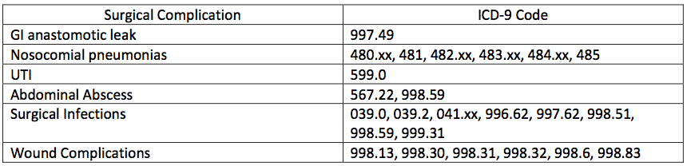
Nestlé IMPACT Formula – Complications Reviewed
IMPACT formulas have been shown to reduce the risk of the following Hospital Acquired Conditions:

Slide 44
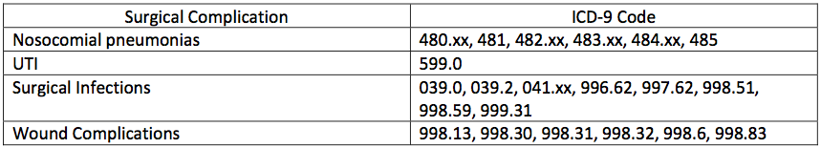
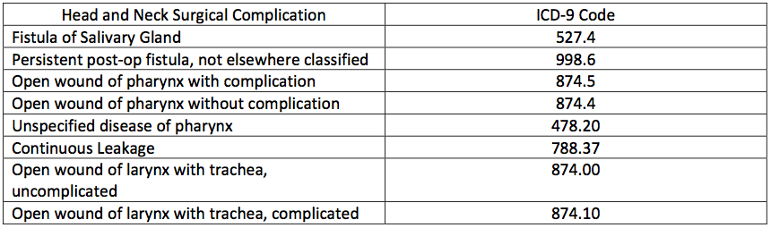
Nestlé IMPACT Formula – Complications Reviewed

Slide 45
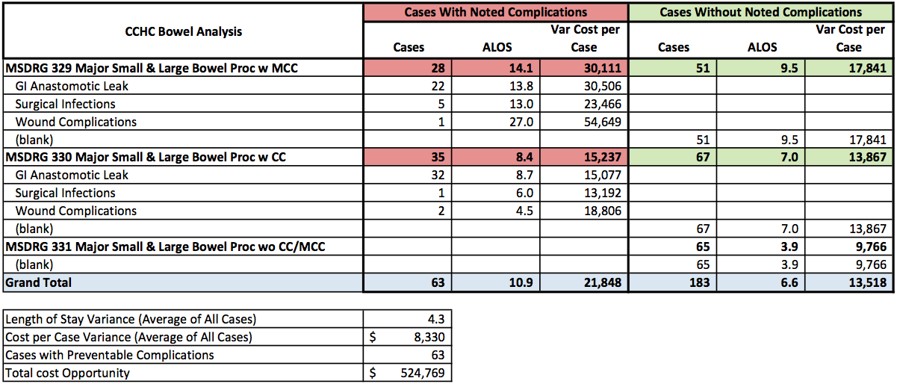
Quick Glimpse of NE Hospital’s Bowel Resection Data
Reduce by 51%

Slide 46
Quick Glimpse of NE Hospital’s Cardiac Surgery Data
Reduce by 51%
Discharges from 4/1/2013 to 3/31/3014;
168 Total Cardiac Surgery Cases (shown above)

Slide 47
Progress To Date
Approval to move forward (planning & data mining) by steering committee
Live planning session at Nestlé Headquarters – July 1-2, Florham Park, NJ
  Dr. Sabharwal, MedAssets
  Dr. Schilling, MedAssets
  Dr. Ochoa, CMO Nestlé Health Sciences
Concurrent further data review
  Thomas Peterman, MedAssets
  Todd Pelisse, MedAssets
Project Plan/Gantt Chart development with milestones and KPIs
Present back to steering committee (CFO, CMO, CMIO, VP Phys. Svc., Supply Chain/Materials Managment)
Final approval received from steering committee for kick-off and Implementation

Slide 48
Progress To Date (cont.)
Review Gantt chart and project milestones
  Follow up live meeting in Denver
Finalize Vendor/Supplier risk sharing agreement
  Initial cases of supply provided at no cost
  Several other ways to invoke supplier risk
    Outcomes based, etc.
Engage nutritionist(s)
Engage supply chain/materials management
Engage key GI surgeons
  Dr. Ochoa, CMO Nestlé; Live forum

Slide 49
Next Steps
Develop multi-disciplinary team
  Supply Chain / Materials Management (Lead)
  Nutrition Services
  Pre-Op Clinic
  ICU Dietary
  Physician Offices
External support via: Nestle & MedAssets
  Education
  Training
Launch nutrition protocol
Monitor compliance, results and outcomes
Hold suppliers accountable for results

Slide 50
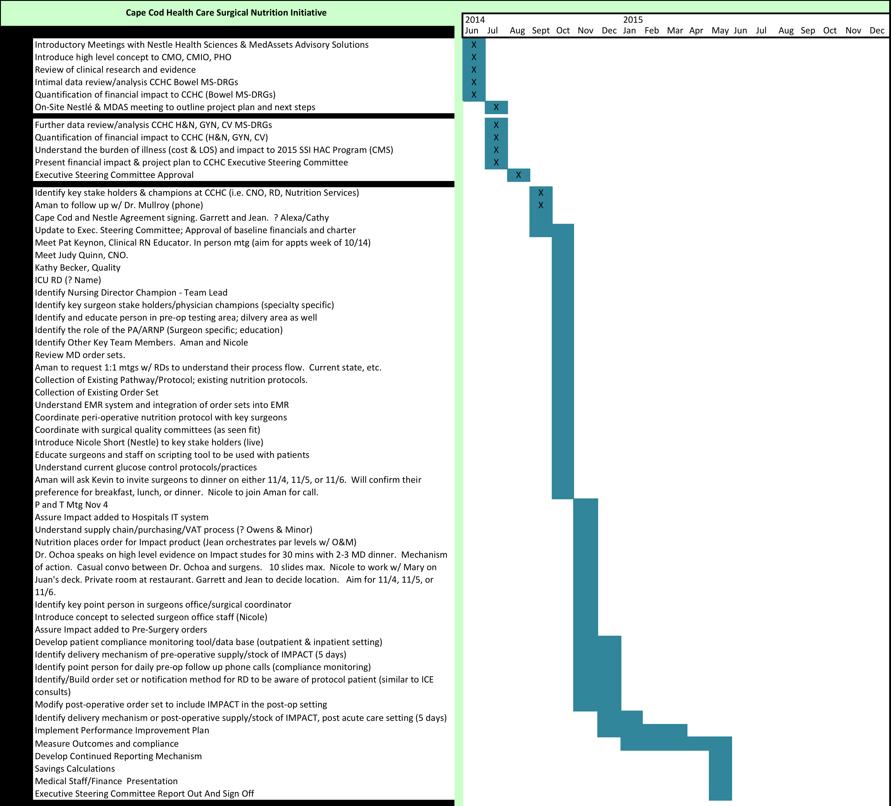
Gantt Chart

Slide 51
Synergies Exist Between All Hospital and Physician Quality Domains…Where Do Suppliers Fit In?
Medicare Spending per Beneficiary
Cost Composite Score
Supplier
Risk Sharing

Slide 53











































Charts
Technology
Documents
People
Medical
Buildings
If you need an icon and its not shown here please contact Corporate Marketing.

Slide 54





































Arrows
Finance
Tools
Marks
Measure
If you need an icon and its not shown here please contact Corporate Marketing.

Slide 55














Communication
Maps
Misc
If you need an icon not shown here, please contact Corporate Marketing.

