Slide 2
Justin Freed, Executive Director of Supply Chain
Gary Botimer, MD, Chief of Orthopedics
Ilsa Nation, RN, CNOR, Director of East Campus O.R.
Taking Back the O.R.
Introducing a Rep-less Model

Slide 3
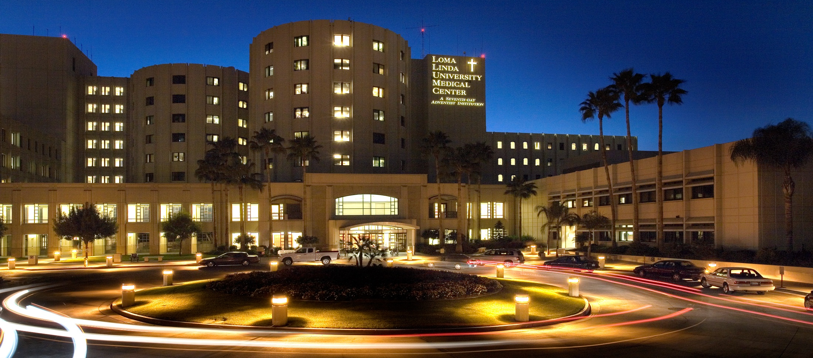

Faithful to Our Mission:
To continue the teaching and healing ministry of Jesus Christ.
Founded in 1905.
(Justin to insert pic of LLUMC and speak to the Mission of LLUMC)

Slide 4
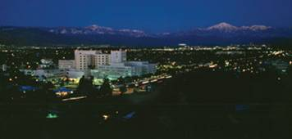
Loma Linda University Medical Center
297 ICU Beds
629 Acute Beds
89 Behavioral Beds
61 Rehab Beds
1076 Total Licensed Beds
University
Hospital
90 ICU
281 Acute
371 Beds
Children’s Hospital
84 NICU
99 ICU
165 Acute
348 Beds
East Campus Hospital
8 ICU
65 Acute
61 Rehab
134 Beds
Behavioral Medicine Center
89 Behavioral
89 Beds
Heart & Surgical Hospital
4 ICU
24 Acute
28 Beds
Murrieta
12 ICU
94 Acute
106 Beds

Slide 5
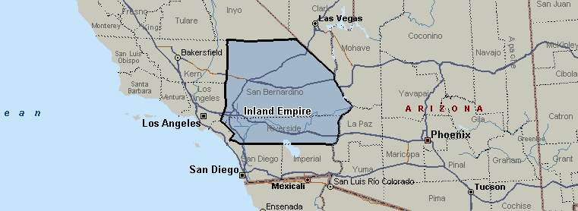
Region in Focus: Inland Empire
Serving the Inland Empire for Over 100 Years
_{LLUMC}

Slide 6
LLUMC Health Payer Mix
Source: OSHPD, 2012, LLUMC.
Note: all data excludes normal newborns.

Slide 7
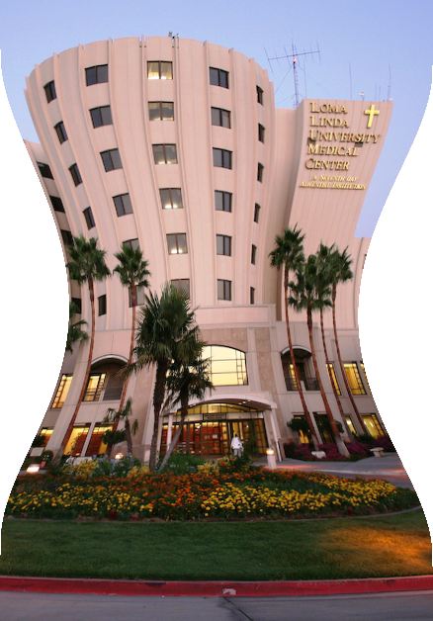
Healthcare Pressures
External
Internal
The “Knowns” and Unknowns of Obamacare
CMS Initiatives
Value Based Purchasing
Stewardship and Financial Health of LLUMC
Demographics
Competition in the Market place
Preservation of one of the last U.S. Christian Medical Schools
Notes:
External Pressures
“Knowns and Unknowns of Obamacare
CMS Initiatives
Bundled Payments
Patient Referrals and Reimbursement rates based on provider quality and cost efficiencies
Value Based Purchasing
Focus on Quality not Quantity

Slide 8
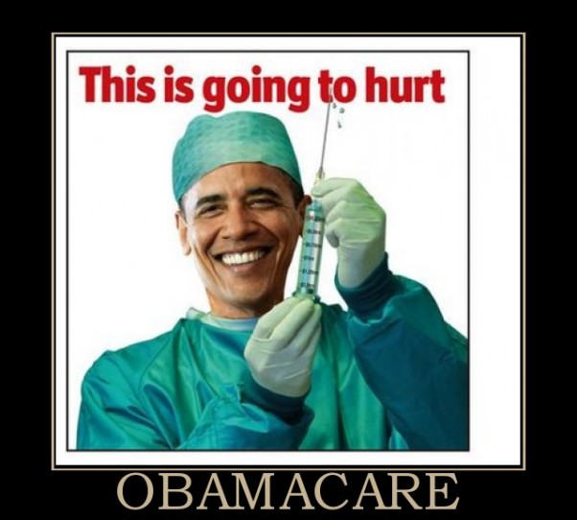
Obamacare
Notes:
External Pressures
“Knowns and Unknowns of Obamacare
CMS Initiatives
Bundled Payments
Patient Referrals and Reimbursement rates based on provider quality and cost efficiencies
Value Based Purchasing
Focus on Quality not Quantity

Slide 9
Healthcare Pressures
External
Internal
The “Knowns” and Unknowns of Obamacare
CMS Initiatives
Value Based Purchasing
Stewardship and Financial Health of LLUMC
Demographics
Competition in the Market place
Preservation of one of the last U.S. Christian Medical Schools
Notes:
Internal Pressures
Stewardship and Financial Health of LLUMC
Goal is to reduce our losses on Medi-Cal / Medic-Aid Reimbursements so that we can try and break even on Medi-Care reimbursements because the ability to cost shift is being significantly diminished
Demographics
Serving the 2 largest counties in the nation by land mass
Largest Private MediCAL / Medic-Aid Provider in CA
75% of Children’s Hospital patients are MediCAL
Competition in the Market Place
Preservation of the last U.S. Christian Medical School

Slide 10
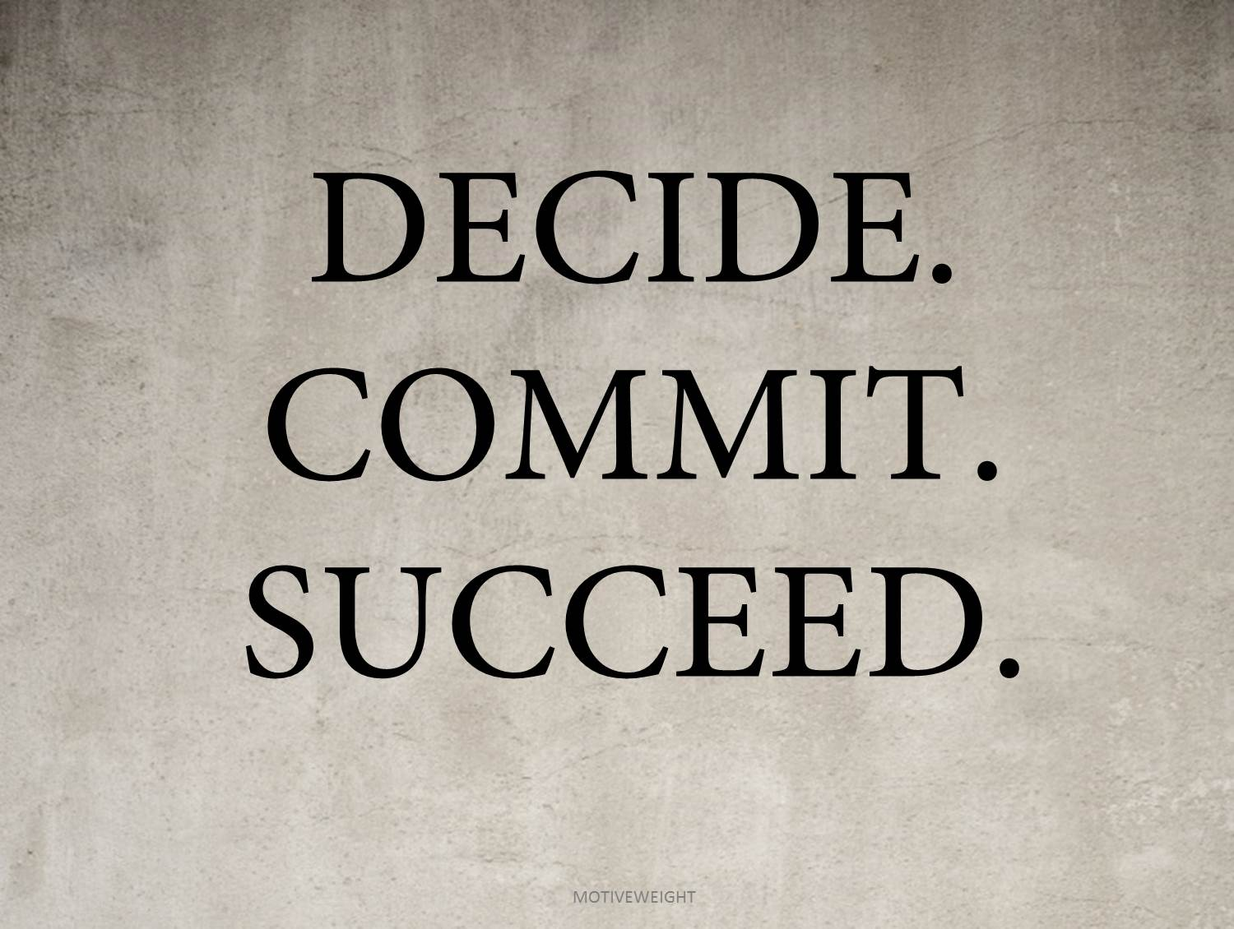
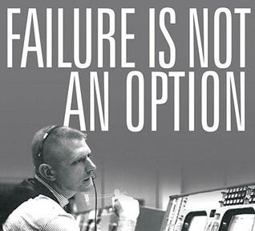

Overcoming Healthcare’s Pressures…
Notes:
Since Failure is NOT an Option:
- We had to Take Back Control of Our O.R.
- We had to change our culture
- We had to rethink how we operate / Re-engineer the procurement & clinical processes

Slide 11

LLUMC Goes …
BACK TO SCHOOL
“Disruptive Re-engineering of the Orthopedic Supply Chain”

Slide 12
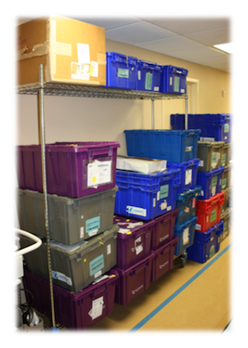
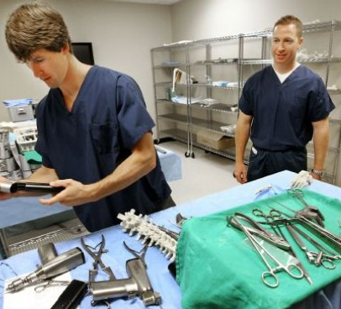
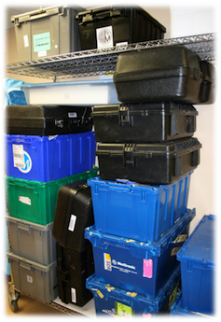
Understanding the Traditional Ortho Supply Chain
Inefficiencies & Hidden Distribution Costs
Notes:
Inefficiencies & Hidden Distribution Costs
Consignment
“Nothing is Free” – Consigned Instruments, Implants and Sales Reps are all built into the cost of implants
Push Distribution Model
Hundreds of Millions of Dollars of Implants and Instruments are pushed on Providers from the traditional Orthopedic Industry via thousands of sales reps
Many participants in the supply chain adding cost, but not value

Slide 13
Traditional Supply Chain Model
TRADITIONAL MODEL
Contract Manufacturer
OEM (Zimmer, Biomet)
GPO
Distributor or Agent
Sales Rep
Hospital or ASC
Traditional P&L of Knee
Selling Price | $5,000 | 100%
COGS | - $1,250 | - 25%
SG&A | - $2,000 | - 40%
R&D | - $250 | - 5%
Operating Profit | $1,500 | 30%
Copyright © 2014, OrthoDirect USA, LLC. All rights reserved. Do not duplicate content or graphics without permission.
Notes:
The Traditional Orthopedic Supply Chain Model contains many cost adding layers.
We are addressing THE COST OF THE PROCESS
These numbers represent the Approximate Industry P&L
Contract Manufacturer: Actually manufacturers the orthopedic implant from raw materials and sells it to the OEM (Recognizable Brand Ortho Company)
Original Equipment Manufacturer (OEM): Despite the title, may not be the physical manufacturer; They hold patents and FDA 510K clearances; These are the recognizable brands; the marketing genius behind the promotion of Orthopedic products
Group Purchasing Organization (GPO): Bundles the purchasing volumes of multiple providers in the hopes to provide some reduction in cost
Distributor or Agent: The entity between the OEM Orthopedic Company and the Provider; Typically oversees a region; Goal is to sell as much as possible for as much as possible
Sales Rep: Recognizable currier who physically transports implants and instruments in and out of hospitals; Maintains relationships with surgeons
Hospital or Ambulatory Surgery Center (ASC): You, the Provider; End User

Slide 14
COGS of Traditional vs. Direct-Access™ Supply Chain Model
TRADITIONAL MODEL
Contract Manufacturer
OEM (Zimmer, Biomet)
GPO
Distributor or Agent
Sales Rep
Hospital or ASC
Traditional P&L of Knee
Selling Price | $5,000 | 100%
COGS | - $1,250 | - 25%
SG&A | - $2,000 | - 40%
R&D | - $250 | - 5%
Operating Profit | $1,500 | 30%
Notes:
Cost of Goods Sold
Contract Manufacturer: Actual cost of raw materials, time to machine and minimal labor and oversight
Original Equipment Manufacturer (OEM): Overhead of large, cumbersome and expensive Orthopedic Companies, “bricks and mortar” for massive headquarters like the ones located in Warsaw, IN.

Slide 15
SG&A of Traditional Supply Chain Model
TRADITIONAL MODEL
Contract Manufacturer
OEM (Zimmer, Biomet)
GPO
Distributor or Agent
Sales Rep
Hospital or ASC
Traditional P&L of Knee
Selling Price | $5,000 | 100%
COGS | - $1,250 | - 25%
SG&A | - $2,000 | - 40%
R&D | - $250 | - 5%
Operating Profit | $1,500 | 30%
Copyright © 2014, OrthoDirect USA, LLC. All rights reserved. Do not duplicate content or graphics without permission.
Notes:
Sales, General & Administration (SG&A)
Group Purchasing Organization (GPO): Fees collected by GPO for their services, approx. 2% of cost of Implant
Distributor or Agent: 30-50% Commission built into cost of Implant (covers operating expenses of Distributorship and Sales Reps Commission)
Sales Rep: 5-15% Commission paid by Distributor or Ortho Company

Slide 16
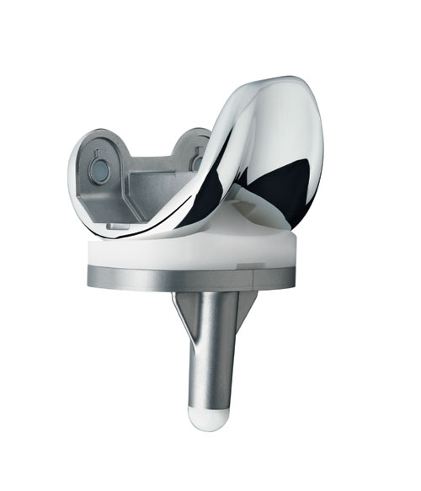
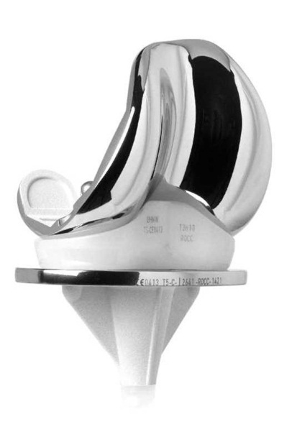
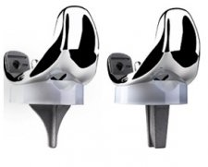
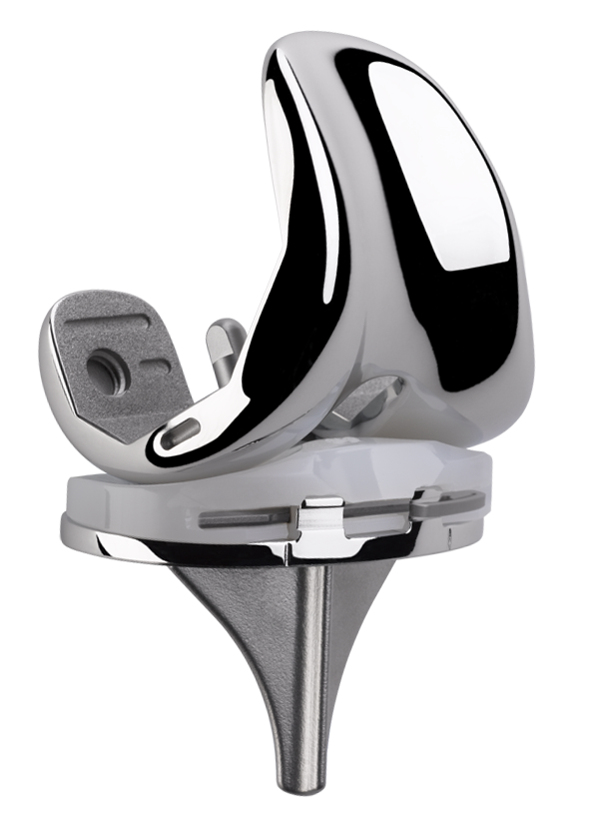
  Commoditization of Orthopedic Implants
Notes:
The Commoditization or Orthopedic Implants
Most are FDA 510K cleared. Which means that they are all functionally equivalent have not changed
Approximately 75% of the Orthopedic Implants on the market today are either “off-patent” or have patents that will expire in the next 2-3 years.
Marketing driven, for Example:
“Gender Specific Knees” = Wide or Narrow options
“Get Around Knee” =
“Metal on Metal” = Marketed as “latest and greatest”… Failed miserably.
New Implants are no better than Old… (Next slide)

Slide 17

Commodity Structure of the Ortho Industry
New Models of Implants Not Better, Study Finds
By BARRY MEIERA
Published: December 22, 2011
“New study suggests that the recent technology for artificial hips and knees did not perform any better than older, less expensive designs.”

Slide 18


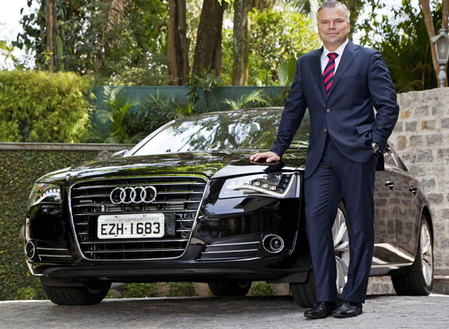
Culture of Subjective Decision Making
Relationships
Brand Loyalty
Rep Influence
Notes:
Culture of Subjective Decision Making
Relationships – Surgeon relationships are stronger with the ortho vendors than with the hospital
Brand Loyalty – Relationships with brands and the familiarity of those brands drive subjective decisions regarding implants
Sales Rep Influence – Studies show that the influence of a rep in the room can significantly increase the cost of surgery via “up-sell.”
LLUMC Ex.: Certain company offered their capitated total joint construct without a proprietary coating, but in surgery the only implant offered to the surgeon was the one WITH the proprietary coating at a significant markup.

Slide 19

On the Outside Looking In
Notes:
We used to feel as if we were not in control of our hospital… We felt as if we were on the outside looking in.
BUT NOW…
We have partnered with our physicians. The whole Direct-Access process is physician focused and physician led.

Slide 20
Traditional vs. Direct-Access™ Supply Chain Models
DIRECT-ACCESS™ MODEL
TRADITIONAL MODEL
Contract
Manufacturer
OEM
(Zimmer, Biomet, etc)
GPO
Distributor
Or Agent
Sales Rep
Hospital
or ASC
Copyright © 2014, OrthoDirect USA, LLC. All rights reserved. Do not duplicate content or graphics without permission.
Notes:
In the existing “Push” model, Provider’s find themselves reacting to a flood of physician product requests introduced and encouraged by company reps
BUT NOW…
After going back to school, we are smarter. The physician loyalties have switched from the vendors to the hospital. We have flipped the script and with the guidance of our Physician Champions, we are making educated decisions regarding the stable implant technologies utilized in our hospital, and we are proactively taking back control of these stable technologies by taking responsibility and ownership.

Slide 21
Direct-Access™ Supply Chain Model
DIRECT-ACCESS™ MODEL
Hospital or ASC
Multiple Manufacturers
Direct-Access™ P&L of Knee
Selling Price | $1,250 | 100%
COGS | - $450 | - 36%
SG&A | - $100 | - 8%
R&D | - $62.50 | - 5%
Operating Profit | $637.50 | 51%
Copyright © 2014, OrthoDirect USA, LLC. All rights reserved. Do not duplicate content or graphics without permission.

Slide 22
Recap of Traditional vs. Direct-Access™ P&L
Traditional P&L of Knee Direct-Access™ P&L of Knee
Selling Price | $5,000 | 100%
COGS + (Lg. Ortho Overhead) | $450 ($800) | - 25%
SG&A | - $2,000 | - 40%
R&D | - $250 | - 5%
Operating Profit | $1,500 | 30%
Selling Price | $1,250 | 100%
COGS of Lean Manufacturer | - $450 | - 36%
SG&A | - $100 | - 8%
R&D | - $62.50 | - 5%
Operating Profit | $637.50 | 51%
Copyright © 2014, OrthoDirect USA, LLC. All rights reserved. Do not duplicate content or graphics without permission.
Notes:
Have we (Physicians) made it too expensive for traditional vendors to do business with us???

Slide 23
Recap of Traditional vs. Direct-Access™ P&L
Traditional P&L of Knee Direct-Access™ P&L of Knee
Selling Price | $5,000 | 100%
COGS + (Lg. Ortho Overhead) | - $450 ($800) | - 25%
SG&A | - $2,000 | - 40%
R&D | - $250 | - 5%
Operating Profit | $1,500 | 30%
Selling Price | $1,250 | 100%
COGS of Lean Manufacturer | - $450 | - 36%
SG&A | - $100 | - 8%
R&D | - $62.50 | - 5%
Operating Profit | $637.50 | 51%
Copyright © 2014, OrthoDirect USA, LLC. All rights reserved. Do not duplicate content or graphics without permission.

Slide 24
Recap of Traditional vs. Direct-Access™ P&L
Traditional P&L of Knee Direct-Access™ P&L of Knee
Selling Price | $5,000 | 100%
COGS + (Lg. Ortho Overhead) | - $450 ($800) | - 25%
SG&A | - $2,000 | - 40%
R&D | - $250 | - 5%
Operating Profit | $1,500 | 30%
Selling Price | $1,250 | 100%
COGS of Lean Manufacturer | - $450 | - 36%
SG&A | - $100 | - 8%
R&D | - $62.50 | - 5%
Operating Profit | $637.50 | 51%
Copyright © 2014, OrthoDirect USA, LLC. All rights reserved. Do not duplicate content or graphics without permission.

Slide 25
Recap of Traditional vs. Direct-Access™ P&L
Traditional P&L of Knee Direct-Access™ P&L of Knee
Selling Price | $5,000 | 100%
COGS + (Lg. Ortho Overhead) | - $450 ($800) | - 25%
SG&A | - $2,000 | - 40%
R&D | - $250 | - 5%
Operating Profit | $1,500 | 30%
Selling Price | $1,250 | 100%
COGS of Lean Manufacturer | - $450 | - 36%
SG&A | - $100 | - 8%
R&D | - $62.50 | - 5%
Operating Profit | $637.50 | 51%
Copyright © 2014, OrthoDirect USA, LLC. All rights reserved. Do not duplicate content or graphics without permission.

Slide 26
Recap of Traditional vs. Direct-Access™ P&L
Traditional P&L of Knee Direct-Access™ P&L of Knee
Selling Price | $5,000 | 100%
COGS + (Lg. Ortho Overhead) | - $450 ($800) | - 25%
SG&A | - $2,000 | - 40%
R&D | - $250 | - 5%
Operating Profit | $1,500 | 30%
Selling Price | $1,250 | 100%
COGS of Lean Manufacturer | - $450 | - 36%
SG&A | - $100 | - 8%
R&D | - $62.50 | - 5%
Operating Profit | $637.50 | 51%
Copyright © 2014, OrthoDirect USA, LLC. All rights reserved. Do not duplicate content or graphics without permission.

Slide 27

Implementation of a Rep-less Model
Engage the help of a Learning Development and Change Management Partner
Notes:
Find a Learning Development and Change Management Partner who:
Is Vendor Agnostic; Represents the Hospitals Interests… Not the interests of the vendors. (Values are aligned)
Knows the ortho industry inside and out
Is accessible 24/7 via onsite mentor to help transition smoothly without missing a beat
Is able to introduce Providers to high quality, low cost implant manufacturers/vendors
Is able to transfer industry knowledge and experience to the Provider staff

Slide 28

Logistics
Establish a Objective Decision Making Process
Notes:
Establish an Objective Decision Making Process:
Led and empowered by a guiding coalition
Guiding Coalition to define values/mission/goals and stable technology implants
Establish a system for objectively evaluating stable technology implants
Execute objective decision making based upon objective evaluation

Slide 29
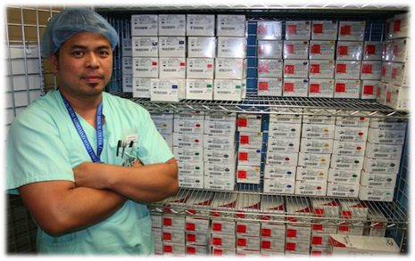
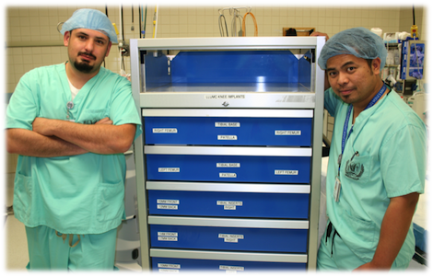
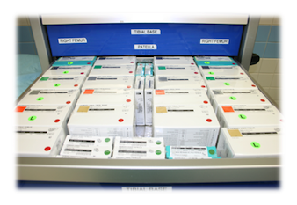
Logistics, continued
Assign Responsibility and Accountability for Managing the Provider’s Orthopedic Service
Notes:
Assign Responsibility and Accountability for Managing the Provider’s Orthopedic Service:
Elevate staff members to Operating Rood Device Technicians (ORDTs) who manage the orthopedic implant service
Implant and Instrument Inventory
Technical and Clinical Support
On-going staff education
Hospital Owned and Managed Implant Inventory
Capital Purchase of Instrumentation

Slide 30

Logistics, Cont.
Educate the O.R. Staff
Notes:
Educate the O.R. Staff:
Supported by Leadership
Led and Facilitated by ORDTs
Clinical basics of “rep-less” procedures
Product Education of “rep-less” products
Systems and Process of management and operation of Hospital-owned Ortho Store

Slide 31


The Grade Card
More Control
More Choices
Lower Costs
Notes:
More Control
Hospital and surgeons maintain control of products and personnel permitted in their O.R.
More Choices
Hospital invites vendors into a more efficient and profitable procurement process
Surgeons are supported by a more educated and better trained staff that executes cases and is able to manage last minute changes/adjustments
Example: Intra-Operative Revision Needs
Lower Costs
Eliminating the cost of consigned reps, implants and instruments reduces the Hospital’s ortho implant spend by more than 50%

Slide 32
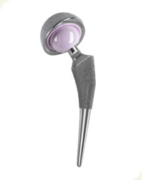
Volumes
More than 90% of Primary Joint procedures are done “Rep-Less”
234 Total Knees
Approximately 62% Reduction in Hospital Spend
154 Total Hips
Approximately 60% Reduction in Hospital Spend

Slide 33
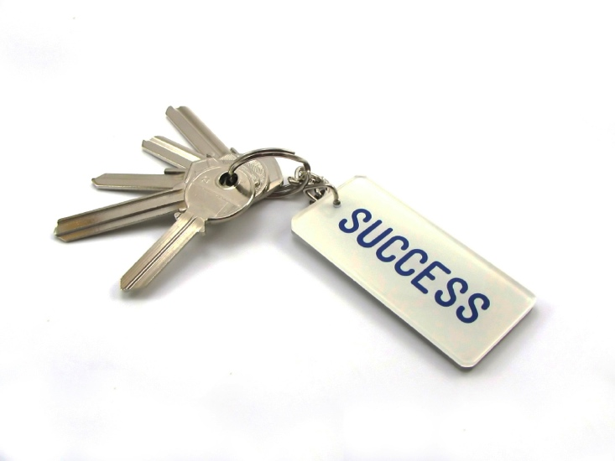
The Keys to Success
1. Clear Vision
1. Physician Alignment
1. Systems & Process Focused, Not Product Focused
1. Collaboration of Direct-Access™ and Capitation Strategies
Notes:
Clear Vision
Collaboration of Executive, O.R. and Supply Chain Leadership
Direct-Access must be Leadership Focused!!!
Physician Alignment
Must have a Surgeon Champion
Direct-Access must be Surgeon Led!!!
Systems & Process Focused, Not Product Focused
Process leads to Product Savings
Long Term Commitment to the Education and Development of Staff
Direct-Access must be Process Driven to ensure Sustainability!!!
Collaboration of Direct-Access and Capitation Strategies
Direct-Access is not all or nothing… It begins where the implementation team defines stable technologies. The beauty is that this process can grow to include as much or as little of your Orthopedic service as you choose.

Slide 34

Thank you…

Slide 35

Questions?

Slide 36
References
Botimer, Gary D., MD. Redefining Value in Healthcare: Why Providers need to take back their OR. 2013.
Gioe, Terence J., MD, Sharma, Amit, MD, Tatman, Penny, MPH, Mehle, Susan, BS. Do “Premium” Joint Implants Add Value?: Analysis of High Cost Joint Implants in a Community Registry. Clin Orthop Relat Res. 2011 January. PMCID: PMC3008865. http://www.ncbi.nlm. nih.gov/pmc/articles/PMC3008865/#CR3.
Herman, Bob. 4 objectives hospitals must pursue to shift successfully to value-based care. Becker’s Hospital CFO Report. June 03, 2013.
Keckley, Paul H., PhD, Coughlin, Sheryl, PhD, MHA, Gupta, Shiraz PharmD, MPH. “Value-based Purchasing: A strategic overview for healthcare industry stakeholders.” Deloitte Development LLC. 2011.
Kowalczyk, Liz. Plans steer patients to lower-cost hospitals. Boston Globe. February 10, 2011.
Marshall, Frank. Hospital Physician Alignment: Managing change in the shifting healthcare environment. January 2011.
Mendenhall, Stan. “Repless” Implants?” Orthopedic Network News. 2010.
Mitchell, Thomas. Case Study: How Loma Linda University Medical Center is taking back their OR and improving access to healthcare. 2013.
Robinson, James C. Value-Based Purchasing For Medical Devices. Health Affairs, Vol 27, Number 6. 2008.
Weisman, Robert. Study: The business model for the medical device industry is unsustainable. Boston Globe. October 2012.

