Slide 1
Syringes and infusion lines – big changes ahead
Rory Jaffe, MD MBA
Executive Director
California Hospital Patient Safety Organization (CHPSO)
Member Small Bore Connectors ISO work group
Some illustrations provided courtesy of ASPEN: American Society for Parenteral and Enteral Nutrition

Slide 2
Introduction
Luer connectors were invented in the late 1890s to provide leak-free connections between glass hypodermic syringes and needles, while allowing easy fitting and removal by pushing together and pulling apart (“Luer slip”). Several years later, a variant was made with threads so that the connectors would be screwed together and secured (“Luer-lock”). Luer fittings became the standard for intravenous use, and then became popular for many other uses requiring small-bore connectors, from attaching blood pressure cuffs to inflation sources to connecting epidural catheters to anesthetic infusions.

Slide 3
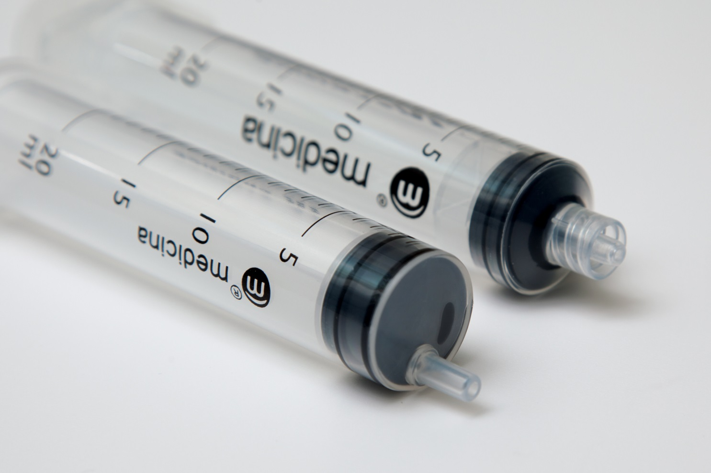
Male “Luer slip” vs. “Luer lock”

Slide 4
Introduction (cont.)
With so many different applications using the same connector, accidental cross-connections, some fatal, began to appear.
Soon there will be international standards for specialized connectors specific to neuraxial (e.g., epidural and intrathecal), blood pressure cuff, enteral and breathing/ventilator systems; each mechanically protected from connecting with the other. These connectors will also be protected from connecting with Luer fittings, which will continue to be used for intravascular and hypodermic applications.
The risk of deadly cross connections will be significantly reduced by adopting physically incompatible connectors for different uses.

Slide 5
Topics covered
Why California mandated the change.
The problem with proprietary solutions.
Standardization and testing of the new connectors.
Plan for introduction of new connectors.
Supply chain challenges, and hospitals’ role in addressing these.
New risks arising during the changeover and after.
Hospital material management challenges.

Slide 6
Why California mandated the change

Slide 7
Case study
Wayne Jowett, an outpatient infusion center patient at Queen’s Medical Centre Nottingham (QMC), was prepared for spinal administration of chemotherapy as part of his medical maintenance program following successful treatment of leukemia.
After carrying out a lumbar puncture and administering the correct cytotoxic therapy (Cytosine) under the supervision of the Oncology Fellow Dr Mulhem, Dr Morton, a Resident, was passed a second drug by Dr Mulhem to administer to Mr Jowett, which he subsequently did.
Unfortunately, whilst emergency treatment was provided very quickly in an effort to rectify the error, Mr Jowett died one month later.

Slide 8
Vincristine
Intrathecal chemotherapy is used for some cancers adjunctive to intravenous therapy, but certain drugs must not be given intrathecally; vincristine is one of those
The first reported fatality from vincristine given in error intrathecally was in 1968
Events continued to occur and continue to this day
This is a catastrophic error, almost always resulting in slow death
External Inquiry into the adverse incident that occurred at Queen’s Medical Centre, Nottingham, 4th January 2001 http://goo.gl/HgEhQ9
The quest to eliminate intrathecal vincristine errors: a 40-year journey Qual Saf Health Care 2010;19:323–326

Slide 9
The two syringes

Slide 10
Different connectors
Incompatible connectors would have prevented this, and most other wrong route errors

Slide 11
Contributing risk factors
Compatible tubing between unlike systems
Luer connectors used for unlike purposes
IV syringes used for oral meds and neuraxial meds
Universal spike for reservoir

Slide 12
Incidence of death from misconnections
Unknown but misconnections can be rapidly lethal: examples
  Neuraxial medications administered intravenously (e.g., bupivacaine)
  Enteral solutions administered intravenously
  IV medications administered neuraxially
  Air from blood pressure cuff connected intravenously
Mostly preventable at low cost with addition of a “forcing function” that prevents cross-connection
Forcing functions common for other connector purposes (e.g., anesthesia machines, medical gases)

Slide 13
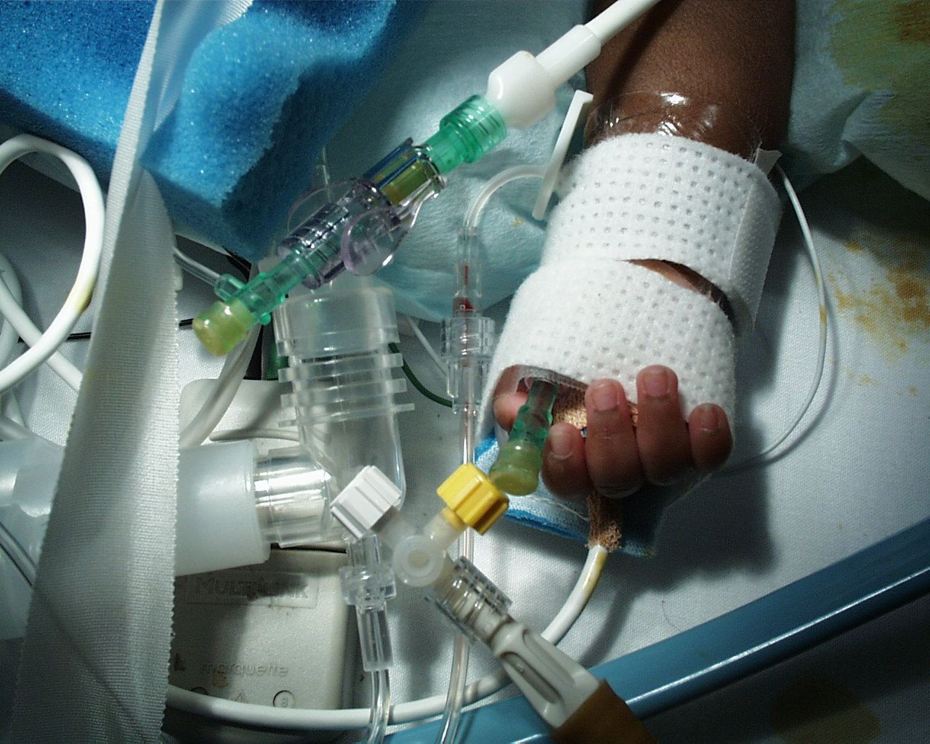

Slide 15
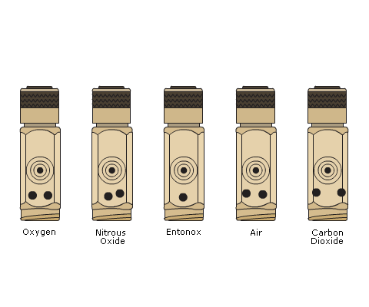
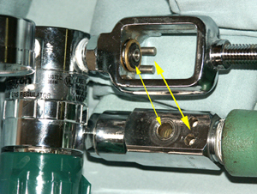
Example forcing function: gas cylinders

Slide 16
Removing the risk factors
California law mandates:
  Incompatible connectors for unlike purposes (epidural vs enteral vs intravenous/hypodermic) by January 1, 2016
  Applies to
    General acute care hospitals
    Acute psychiatric hospitals
    Skilled nursing facilities
    Special hospitals (dentistry or maternity)
California law does not mandate:
  Incompatible reservoir spikes
Most cases seem to be errors at connector level, but still need caution

Slide 17
The problem with proprietary solutions

Slide 18
Proprietary standards have been tried
UK several years ago required non-compatible connectors for neuraxial use, but many problems arose
Some styles of connectors caused usability issues during procedures
Supply chain not standardized
  Some hospitals received distal connectors without proximal mates and didn’t recognize the issue until a clinician could not successfully complete a procedure
  Clinicians received surprises when new styles of connectors showed up
  Patients transferred from one facility to another could face connection barriers if facilities using different proprietary connectors
Not completely sure that the misconnection problem was addressed

Slide 19
Standardization and testing of the new connectors

Slide 20
Scope of the effort
Small bore connectors for liquids and gases in healthcare
Small bore connectors for reservoir delivery systems
80369-1: general requirements for small-bore connectors
80369-2: breathing systems and driving gases
80369-3: enteral
80369-4: urethral and urinary
80369-5: limb cuff inflation
80369-6: neuraxial
80369-7: intravascular or hypodermic
80369-20: common test methods
18250-1: general requirements
18250-2: breathing systems and driving gases
18250-3: enteral
18250-6: neuraxial
18250-7: intravascular
18250-8: citrate-based anticoagulant solution for apheresis
18250-9: irrigation
Italic = under consideration, not in progress

Slide 21
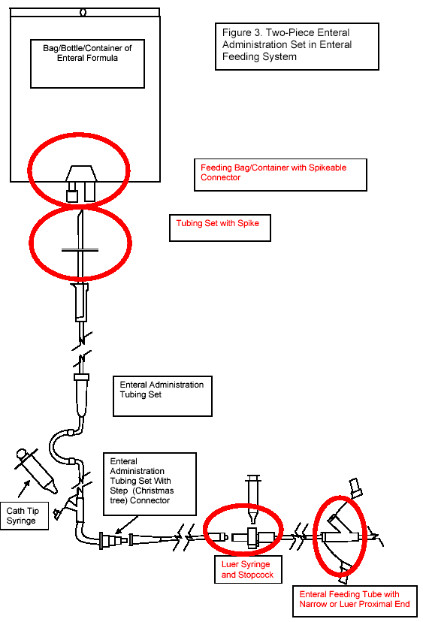
Two sets of standards (80369 and 18250)
Today’s feeding systems
18250: reservoir delivery
80369
80369
80369
80369

Slide 22
The ISO standards process is multinational
31 countries, each with one vote
Each country submits extensive comments and text revisions
  These are approved or not through consensus process
Several rounds of review and voting before standard is published
Process is slow, and some countries have different view of urgency than others
  California deadline is major driver behind current ISO small bore connector standardization timeline

Slide 23
Color coding not in the standards
Different manufacturers and different materials result in range of colors, even when standardized
Color coding relies on memory and vision, not a forcing function
Connectors might be color coded (e.g., purple for enteral), but this is not a standard requirement

Slide 24
Designed to prevent cross-connections
Enteral
Neuraxial
Reversed genders from IV
  Prevents enteral line attachment to patient’s IV
Male distal, female proximal
~ 20 % larger than IV connectors
  Prevents cross-connects
About 20 % smaller than IV connectors
  Male IV connector too large for female neuraxial
Collar on all male connectors, not just lock connectors
  Male neuraxial collar interferes with larger female IV connector, prevents connection

Slide 25
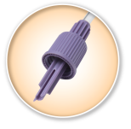
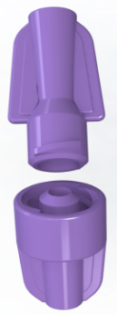
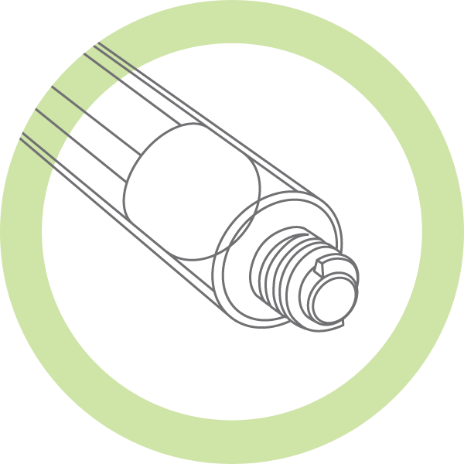
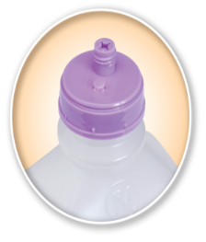
Enteral connector design
Reservoir connector
Patient access
Prevents inadvertent use of IV tubing as an administration set
Prevents inadvertent connection of enteral administration set to IV tubing

Slide 26
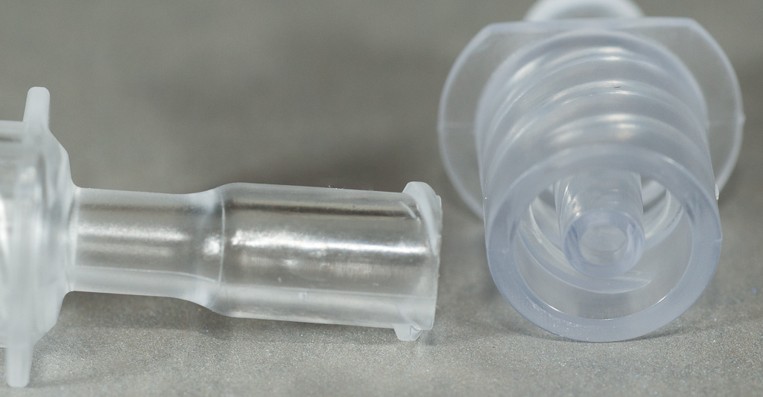
Neuraxial connector design
Reservoir connector
Patient access
Uses standard IV bag “spike”
Does not prevent inadvertent use of IV tubing as an
administration set
Prevents inadvertent connection of a neuraxial fluid line or neuraxial syringe to IV and vice-versa

Slide 27
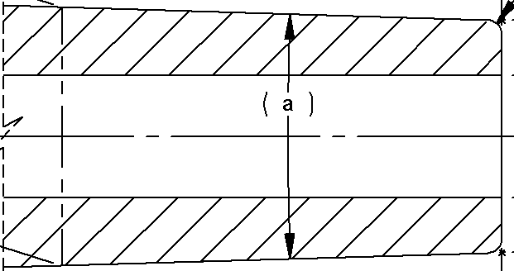
Collar on all neuraxial male connectors, including slip, unlike Luer
Neuraxial slip with collar
Luer slip, no collar
Connectors not drawn to same scale
Draft Specifications, do not use

Slide 28
Connector collar comparison
Neuraxial slip with collar
Neuraxial lock with collar
Draft Specifications, do not use

Slide 29
Extensively tested
Usability
  User testing in simulated environments
Risk of inappropriate interconnection with any other 80369 connector
  User testing
  Computer Aided Design analysis
Failure effects and severity ratings produced for Failure Modes and Effects Analysis (FMEA)
  Expert clinical panel review
  Reviewed every combination of connectors in all anticipated settings
  For example, 57 different failure modes evaluated for neuraxial connectors, prioritized by frequency and severity
FDA review

Slide 30
Usability testing example: enteral
Participants were a mix of caregivers that work in an ICU or NICU, and CNAs or people with a close friend, family member, or themselves that requires enteral feeding and medication administration at home
These three user groups represent a variety of environments where enteral feeding and medication administration is provided. ICU, n=20; NICU, n=20; home, n=24
Participants also represent a mix of ages and genders

Slide 31
Usability testing example: enteral (cont.)
The objectives of the human factors study were to validate:
  Caregivers do not attempt to connect male/female connector from the enteral connector system to other ports coming out of the manikin’s body.
  Caregivers can successfully connect paired male/female enteral connector systems by twisting, or screwing, them into each other.
  Caregivers can successfully administer enteral feeding or medication by having no leaks at the connection site due to participant error.

Slide 32
Usability testing for neuraxial
Due to UK experience with proprietary connectors, extensive testing being conducted in several countries
  Testing currently under way
Neuraxial connector design may affect performance of procedures, e.g.,
  Lumbar puncture with chemotherapy infusion
  Epidural catheter placement

Slide 33
Neuraxial testing results
The first round of testing found that, under certain extreme circumstances, a male neuraxial connector could cross-connect to another male connector
There were many ways it could be redesigned—the committee chose the version that could be tested the fastest, in view of California’s deadline

Slide 34
Neuraxial timeline post-testing
Testing failure resulted in six-month timeline slip
Expect “design freeze” around December 2014 or January 2015

Slide 35
Plan for introduction of new connectors

Slide 36
Goals
Assure clinician usability comparable to current Luer devices
Generate awareness of the reason for and the introduction of global standards
Facilitate rapid adoption of new global standard small-bore connectors
Integrate the new connectors with minimal disruption to the supply chain and clinical practice
Develop and execute timeline delivering focused messaging, programs and measures for success
Manage specific messaging for respiratory, enteral, and limb cuff, neuraxial, and intravascular/hypodermic suppliers (as well as possible future applications) launching the new international small-bore connectors

Slide 37
Overall plan
Aware
Prepare
Adopt
Awareness campaign
In-service & webinars
Product launch & implementation
Measure
Adoption & adherence
3 months
3 months
3 months
3 months
Flush supply chain
Enteral first; neuraxial second

Slide 38
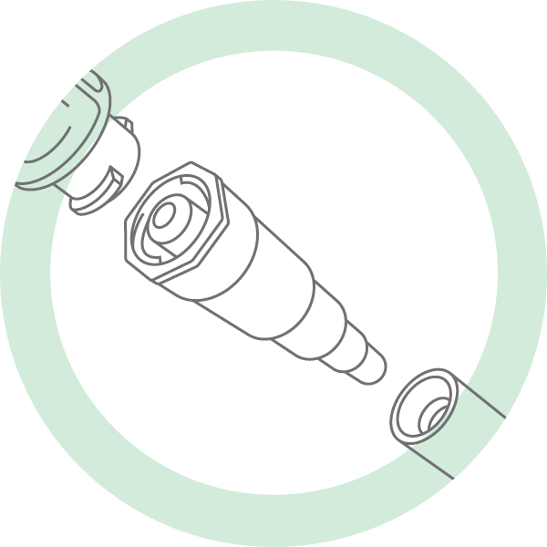
Enteral timeline (USA)
2014 Q4: Customers currently ordering sets with the stepped/Christmas tree connector will receive transition feeding/administration sets. These sets are compatible with both current feeding tube connections and new ISO 80369-3 standard connector.
2015 Q1: Flush and bolus feed syringes with the connector will be available (proximal 80369-3 connector)
2015 Q2: New enteral feeding tubes with ISO standard connector will be available (distal 80369-3 connector)
2016: Current universal connector no longer available, transition connectors no longer needed except for old feeding tubes

Slide 39
Neuraxial timeline (USA)
First product shipped late 2015, some manufacturers may not be shipping until December 2015
  Some manufacturers will not meet deadline
Lines tend not to stay in patient between care settings
  Unlike enteral connectors, expect rollout of proximal and distal connectors at same time
  Will not include transition connectors

Slide 40
Why does it take so long?
Like auto manufacturers, this requires new, expensive tooling
  Most vendors reluctant to start “cutting steel” until standard frozen
  Expect neuraxial standards freeze by January 2015
Multiple product runs required for devices (e.g., syringes) that used to be produced in one run
  May not have capacity to run in parallel
Building molds and tools, then
Sampling, QA, FDA submission, then
FDA approval
  FDA is involved in the standards development process, which should speed consequent device approval
Finally, takes time to “flush out” old devices from supply chain

Slide 41
Information sources for roll out plans
California Hospital Association, Hospital Quality Institute, California Hospital Patient Safety Organization
  Working directly with the manufacturers and ISO standards committees
  One of few clinician representatives active in this phase of adoption
  www.chpso.org/post/new-connectors-are-coming
Enteral connectors: “Stay Connected 2014” www.stayconnected2014.org
  Sign up for mailing list at eepurl.com/K3hCP
  CHPSO is working to facilitate a similar collaboration for neuraxial connectors
Association for the Advancement of Medical Instrumentation (AAMI)
  CHPSO is a member
  www.aami.org/hottopics/connectors/

Slide 42
Supply chain challenges and hospitals’ role in addressing these

Slide 43
Focus on neuraxial connector
Manufacturers not as well organized as for enteral connectors
Market more fragmented, some players have small US market, large world market
Packaged procedure kits often include products from multiple manufacturers
Some manufacturers aggressively proceeding with new tooling and production, others holding back
Supply by January 2016 may be tight and much of supply chain may still contain Luer connector materials
CHPSO working to increase coordination

Slide 44
Purchasers’ influence
January 2016 deadline strictly applies only to California
USA probably will proceed at same pace unless supply is tight
  Current forecast is that suppliers (in general) will barely meet the deadlines for epidural connectors
To ensure compliance with the law, hospitals should identify, as soon as possible, suppliers that should meet the deadline
  Create market demand in advance of changeover, incentivize suppliers that move quickly to meet California legal requirements
  GPOs have prominent role in USA supply chain and should be partner in this effort
  This may mean delaying adoption (by several months) in other states
  This also may mean that GPOs and hospitals will need to switch suppliers if the traditional suppliers might fail to meet the required deadline

Slide 45
New risks arising during the changeover and after

Slide 46
During changeover: Inconsistent adoption of enteral connectors
Certain facilities may adopt the new devices before others do
If a patient with a new feeding tube is transferred to a facility with old devices, that facility cannot use the tube
  Thus the staged rollout, with six months before tubes start being used
If a patient with an old device is transferred to a facility with new devices, a transition connector is needed
Creates delays in care unless recipient facility already has the connector readily available or a transition connector is supplied for transport
Recommendations:
  Include assessment of connector types on transfer and on admission to anticipate and resolve connector challenges
  Ensure that facility is fully stocked with new feeding/administration sets (with transition connectors) before the new feeding tubes hit the market

Slide 47
Proximal spike for neuraxial uses
No change in proximal spike, so both neuraxial and intravenous administration sets can attach to neuraxial and intravenous solution reservoirs
Supplying an intravenous administration set with a neuraxial solution will “force” intravenous administration unless caregiver double checks
Accidentally mixing intravenous and neuraxial sets in a bin could lead to wrong route errors
Recommendations:
  Manufacturers plan to prominently distinguish connectors on the label, details not finalized
  Pharmacy can package neuraxial fluid reservoirs with neuraxial sets (e.g., rubber band together)
  Consider whether stocking neuraxial sets on wards is wise or not (e.g., risk of mix-ups in bins)

Slide 48
Mis-filled syringes or fluid reservoirs
Remain an issue, currently appears to happen much less frequently than misconnections of properly filled containers
Nurses still need to be aware of correct route for each medication, and systems (e.g., CPOE) should continue to check for proper route
The new connectors are a component of “defense in depth” for potentially disastrous events, not a substitute for current defenses

Slide 49
Hospital material management challenges

Slide 50
Material management changes
More SKUs
  Syringes in at least three fitting types, multiple types for needles, etc.
  Infusion pump tubing in multiple types
  Connectors, other tubing, etc.
Need to identify where neuraxial and enteral uses occur
  In past, didn’t necessarily need different types of fittings on the wards, now will
Stock “transition connectors” during the transition period
  Enables cross fit conic-ended enteral tubes to new fitting
Recommend facility-wide rollout rather than ward by ward
  Supply chain will be rapidly emptied of old-style connectors for use-specific devices (e.g., spinal needles, feeding tubes)
  Differently phased rollouts will confuse and frustrate clinicians who work in multiple locations
  Will roll out proximal and distal sets separately for enteral uses, using bridge connectors in the transition
  Neuraxial devices tend to stay in patients for less time, roll out proximal and distal sets simultaneously

Slide 51
Potential material management surprises: neuraxial
Intravenous/hypodermic supplies may currently be used for neuraxial uses without the knowledge of materials management
  Major nerve blocks, while not technically “neuraxial”, will be included
  Common needles (e.g., 22g long) may be needed in both Luer and neuraxial fittings
  IV catheters may also be used for major nerve blocks
May be asked to supply neuraxial connectors for chemical nerve ablation use, such as in a pain clinic
Pharmacy, clinician-users, and materials management need to coordinate plans

Slide 52
Other potential neuraxial material management surprises
Spinal needles may be used for non-neuraxial purposes
  E.g., amniocentesis, joint space aspiration
  These uses will also need to be converted to the new connectors
California law only requires the new connector for epidural uses
  Some manufacturers, strapped for time, may delay production of the new spinal needles
Inventory neuraxial uses and supply needs through questionnaire: sample survey will be sent to webinar participants
  At a minimum, include oncologists, anesthesiologists, pain specialists, interventional radiologists, and ED physicians in the survey

Slide 53
Potential material management surprises: enteral
Medication administration may be carried out in different ways
  Work with pharmacy to identify medication uses
Many of the enteral lines the hospital deals with were introduced into the patient elsewhere
  Patients will come in to hospital with a variety of connector types for their indwelling enteral lines
  Work with GI, nursing, to identify current connector use, current workarounds for odd connectors, etc., then find ways to address these issues with the new connector sets
  Patients changing feeding tubes at home may use cut-off Foley catheters to save money, and thus may still have conic connectors even after new feeding tubes are on the market

Slide 54
Other recommendations
Prepare by assessing systems processes and protocols that may need to change
Work with suppliers to coordinate transition plans
Plan to train clinicians and materials management staff for impending changes
Be aware that one neuraxial use still not covered by connector plans: epidural blood patch, an uncommon procedure requiring both intravenous and neuraxial access
  May need to “cobble together” items to have a useful procedure kit
  Probably will get guidance from Anesthesiology societies

Slide 55
Stay tuned for more
CHPSO continues to work to address these issues
Subscribe to CHPSO newsletter (eepurl.com/od9Qj), CHA daily news
Contact Rory Jaffe (rjaffe@chpso.org) with any questions

Slide 56
Questions

Slide 57




HQI Inaugural Annual Conference
November 6 & 7, 2014
Hyatt Regency | Huntington Beach, CA
For additional information and registration

